Slide 1
The 50% Cheaper Agent
Autonomous LLM routing with Bayesian Bandits
Shrinidhi Mahishi
Principal Data Scientist
Red Hat

Slide 2
What we will cover today
Cost of Single-Model Routing
Challenges of Missing Labels in Production
Turning Telemetry into a Reward Signal
How Bayesian Bandits Make Routing Decisions
Production Hardening for Real-World Traffic
Results, Limits and Future Work

Slide 3
One Model For Everything?
The pitfalls of sending all LLM traffic through a single model
trending_up
Always Strongest
High Cost
savings
Always Cheapest
High Risk
settings
Hardcoded Rules
Go Stale
LLM = Large Language Model

Slide 4

Why Routing Is Hard In Production
Research Assumption
- Research Assumes Labels
- Production Usually Doesn’t Have Them
No human labels
Provider drift
Latency constraints
Reliability requirements
Safety requirements

Slide 5
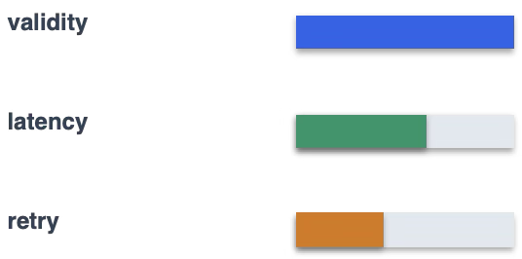
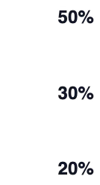

Reward From Telemetry
The Reward Formula
Reward = 0.50 * Validity
+ 0.30 * Latency
+ 0.20 * Retry
Telemetry becomes the learning signal.

Slide 6
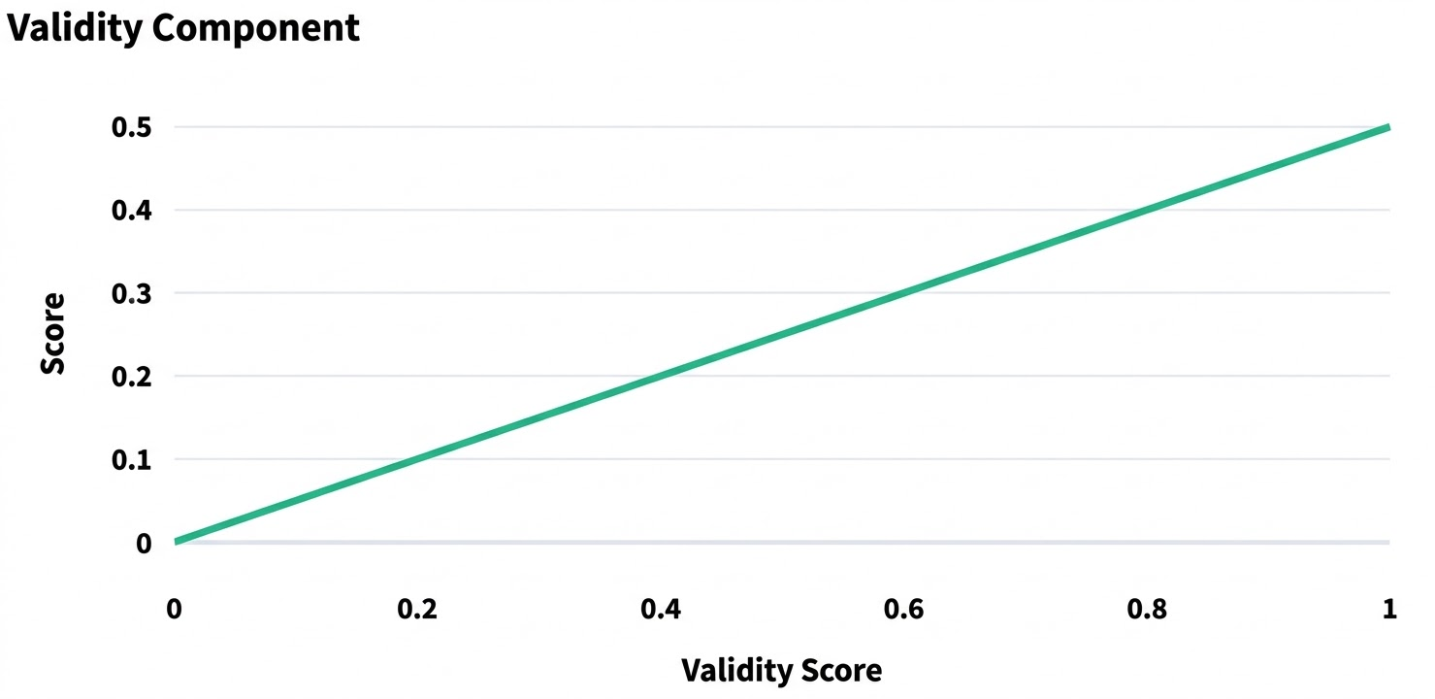
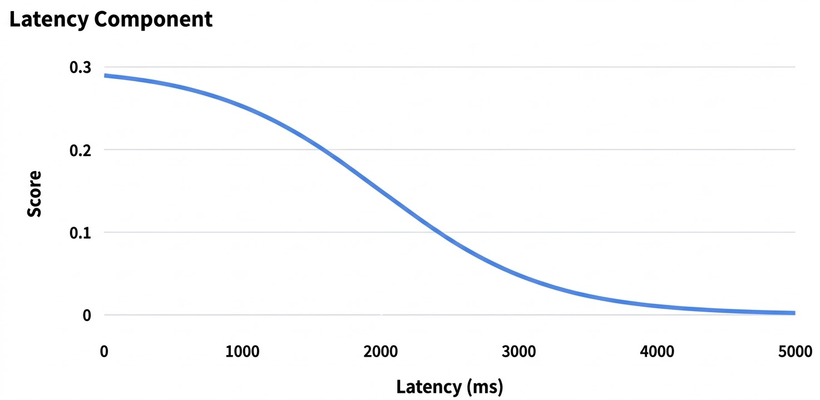
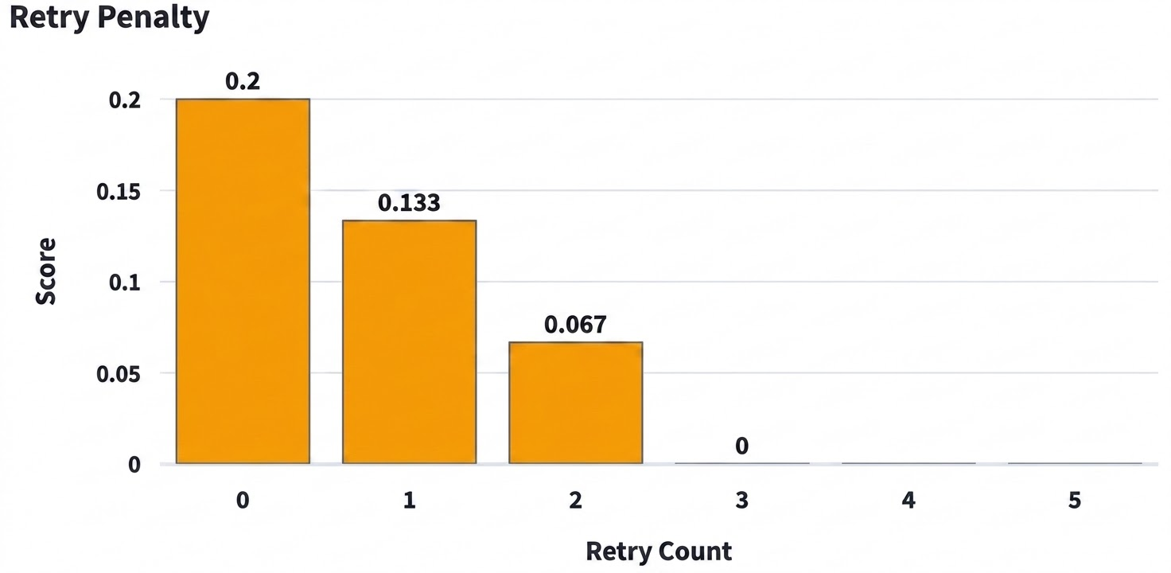
Reward From Telemetry

Slide 7
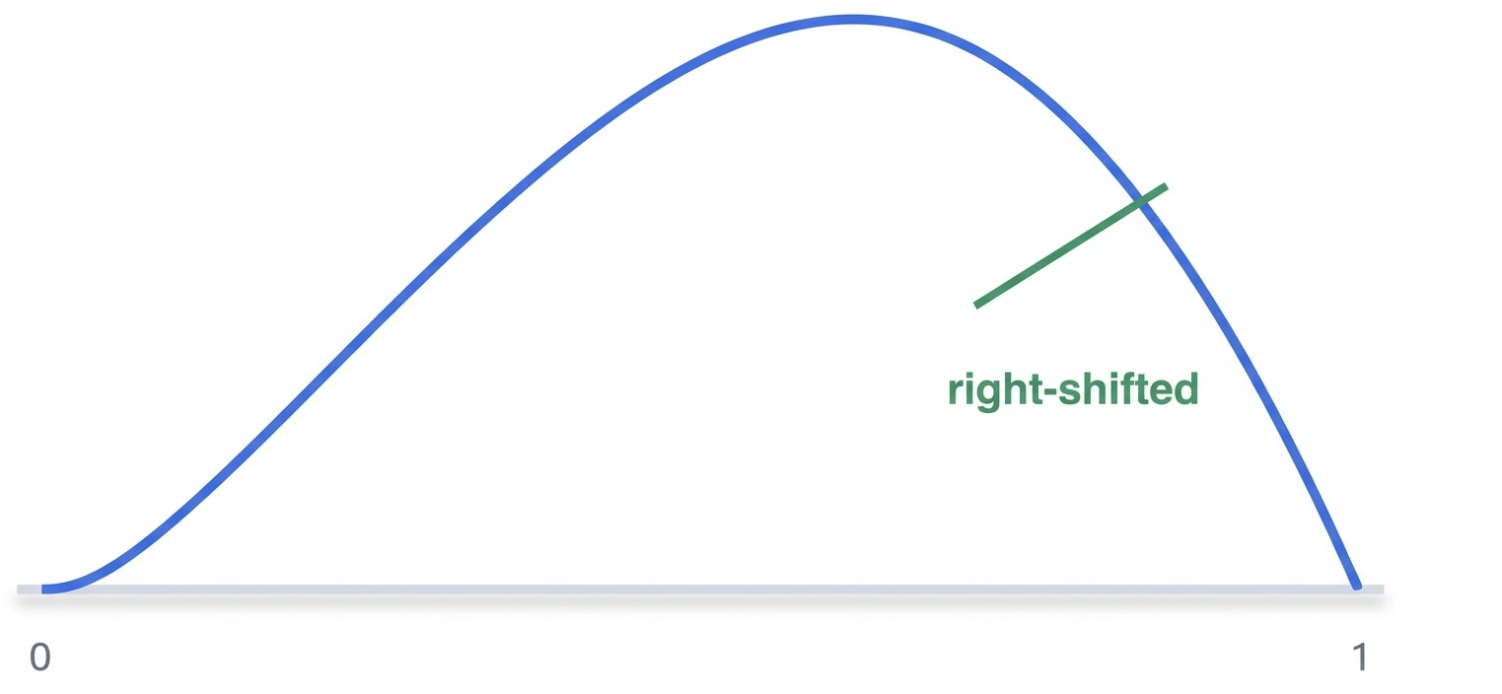
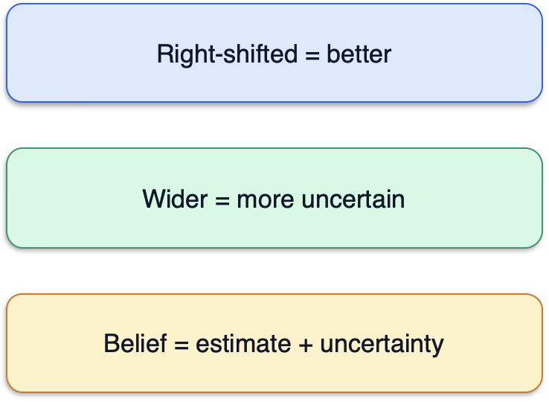
What The Belief Looks Like
Belief = Beta(⍺, β) ⍺ = success evidence β = failure evidence Confidence = ⍺/(⍺ + β)
GPT-4o ~ Beta(8, 3) Confidence = 8/(8+3) = 0.727 Router estimates GPT-4o quality ~ 0.73

Slide 8
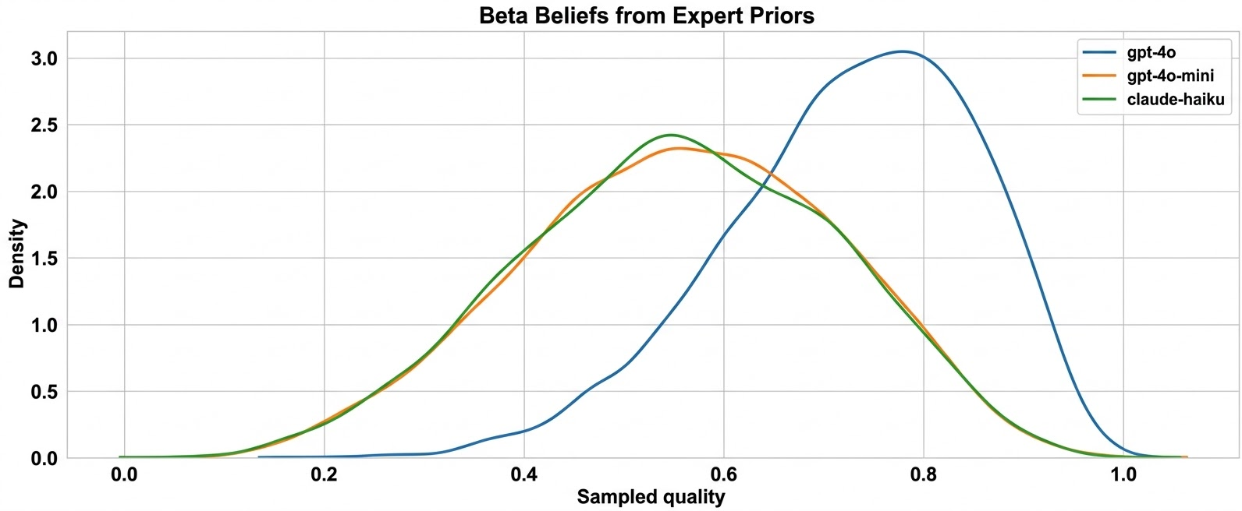
What The Belief Looks Like

Slide 9
Why Thompson Sampling
SELECTION RULE
LIVE EXAMPLE
Draw one sample from each belief
Highest sample wins
Uncertain models still get chances
GPT-4o 0.78
GPT-4o-mini 0.74
Claude-Haiku 0.81 ✓ SELECTED
Exploration is proportional to uncertainty.

Slide 10
One Request, End To End
Belief before
GPT-4o = Beta(8,3)
Chosen model
GPT-4o
Telemetry
Validity_Score = 1.0
Reward
0.875
Belief after
GPT-4o = Beta(8.875, 3.125)

Slide 11
One Request, End To End
State before the request
Evaluations
State after the request
model | alpha | beta | confidence
gpt-4o | 8 | 3 | 0.727
gpt-4o-mini | 3 | 2 | 0.6
claude-haiku | 3 | 2 | 0.6
Primary: gpt-4o
Telemetry: Latency: 3400 ms | Validity: 1.0 | Retries: 0
Reward: 0.743 (latency=0.043, validity=0.5, retry=0.2)
model | alpha | beta | confidence
gpt-4o | 8.743 | 3.257 | 0.728
gpt-4o-mini | 3 | 2 | 0.6
claude-haiku | 3 | 2 | 0.6

Slide 12
Production Hardening I: Expert Priors And Decay
psychologyExpert Priors
Avoid the "Cold Start" problem by initializing with domain knowledge.
Start with informed beliefs: Don't begin with a blank slate.
Example: gpt-4o = Beta(8,3) instead of a uniform Beta(1,1).
history_toggle_offDecay
Ensure the system remains adaptive to model performance shifts over time.
Adaptation: Every N requests, shrink ⍺ and β toward 1.
Goal: Prevent old evidence from over-weighting future routing decisions.

Slide 13
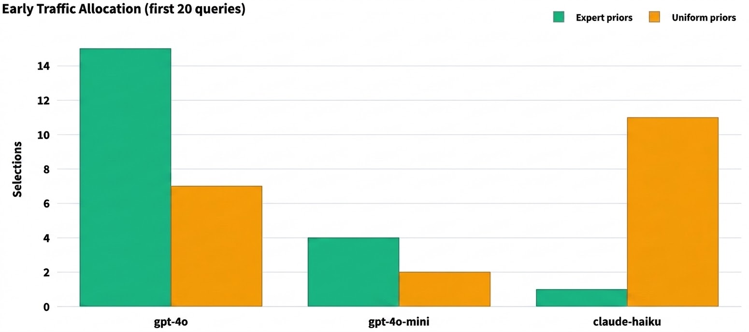
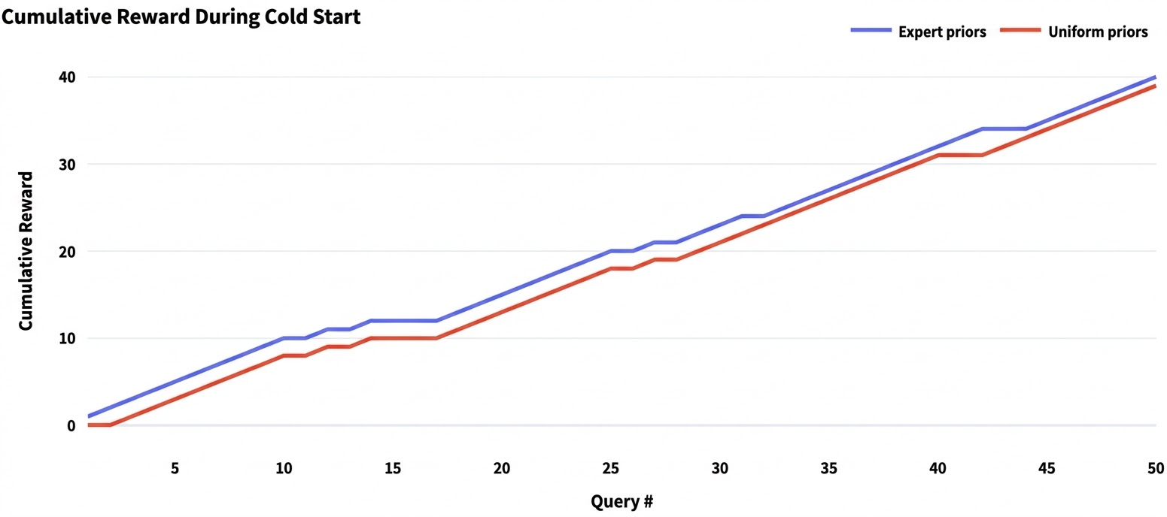
Production Hardening I: Expert Priors

Slide 14
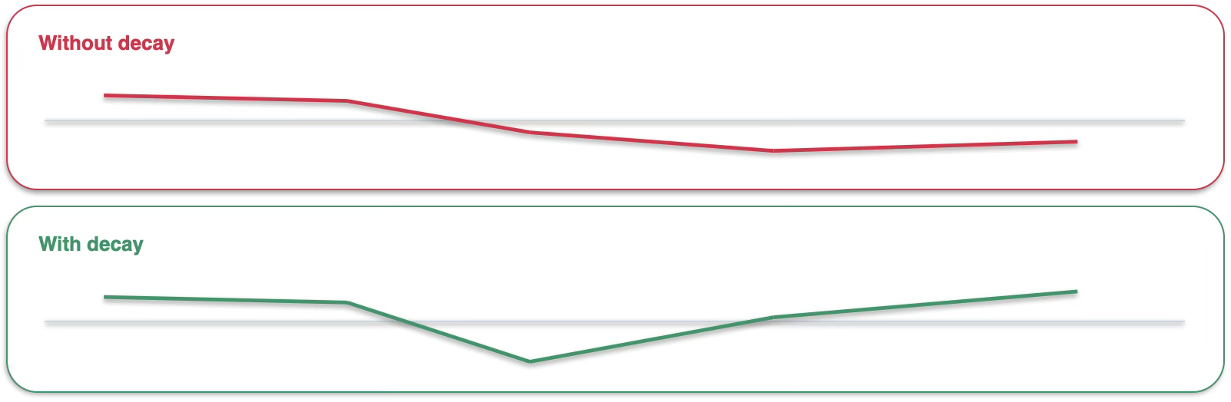
Production Hardening I: Decay
When the strong model degrades, stale history becomes a liability. x-axis: Time y-axis: Routing Quality

Slide 15
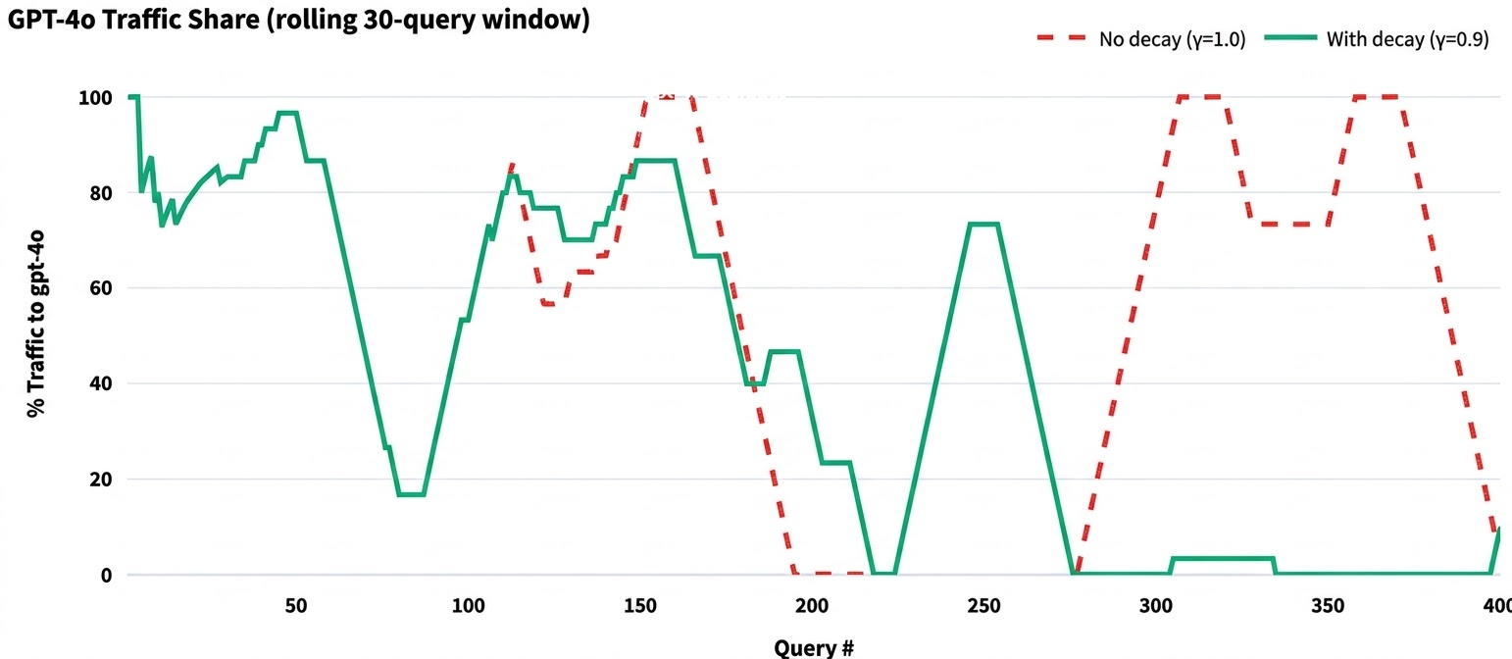
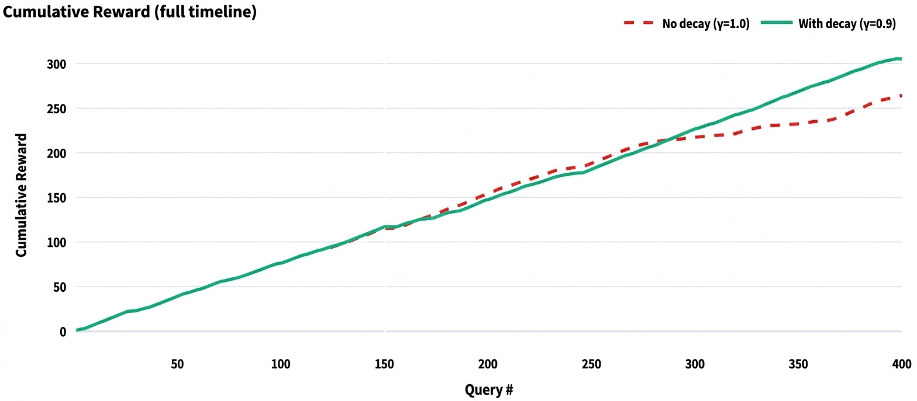
Production Hardening I: Decay

Slide 16
Production Hardening II: Safety Layers
Fallback
Protects against low-confidence choices.
Shadow Evaluation
Learns safely in the background.
Circuit Breakers
Remove unhealthy models.

Slide 17
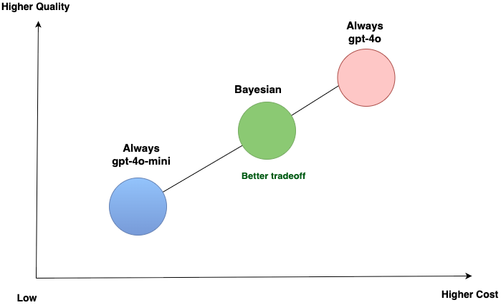
Results
Always GPT-4o Strongest quality, highest cost
Bayesian Router Sits in the middle by using the strong model when needed and cheaper models when safe
Always GPT-4o-mini Weaker quality, lowest cost

Slide 18
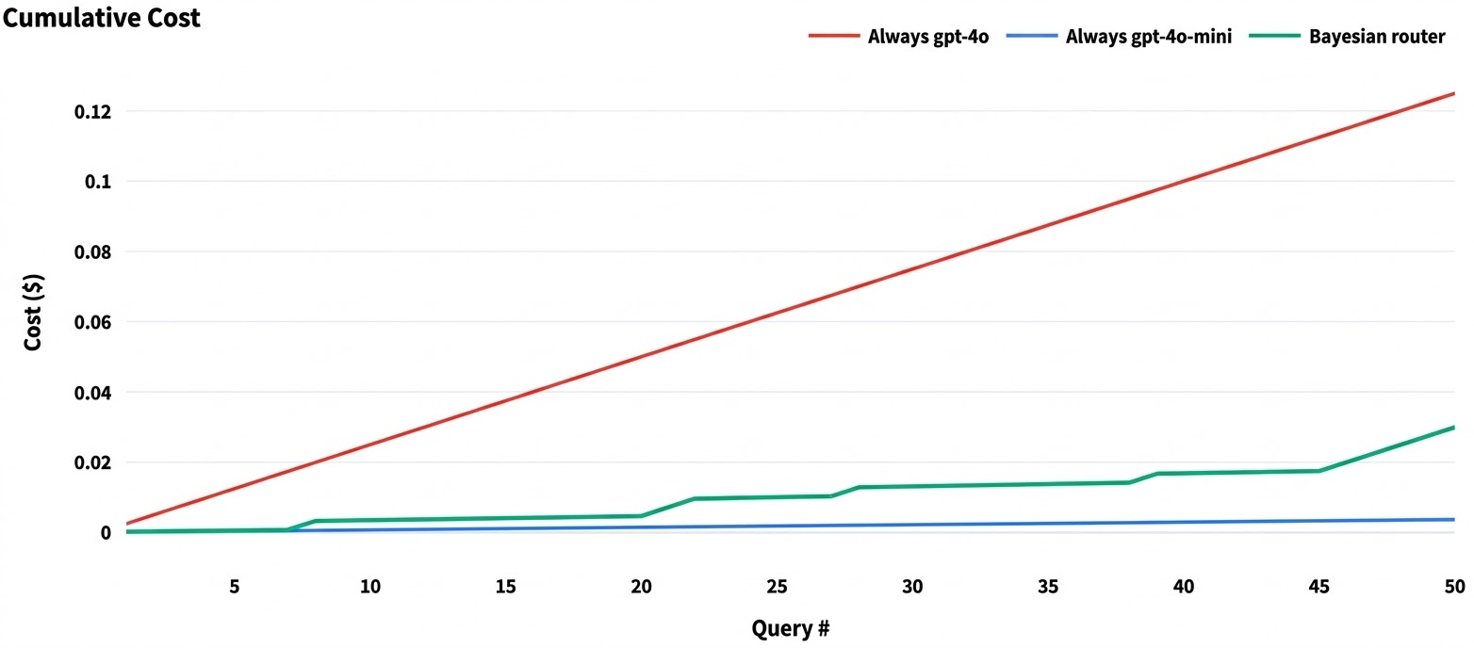
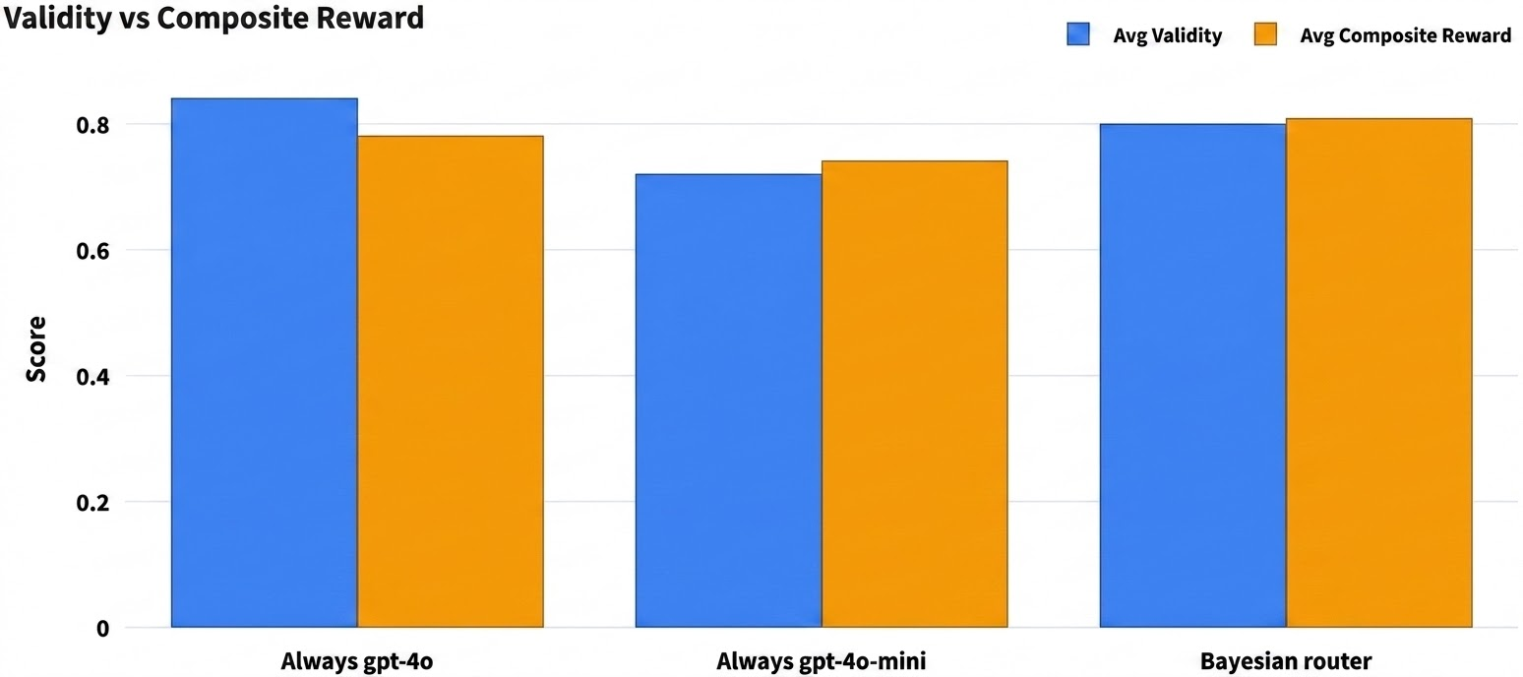
Results

Slide 19
Limits & Future Work
warning_amber
trending_up
Limits
Non-contextual: Learns overall model health
Reward: These are proxy signals not the ground truth
Pragmatic Adaptation: An applied implementation, not an exact textbook Bayes approach.
Future Work
Contextual Routing: Routing logic based on specific query types

Slide 20
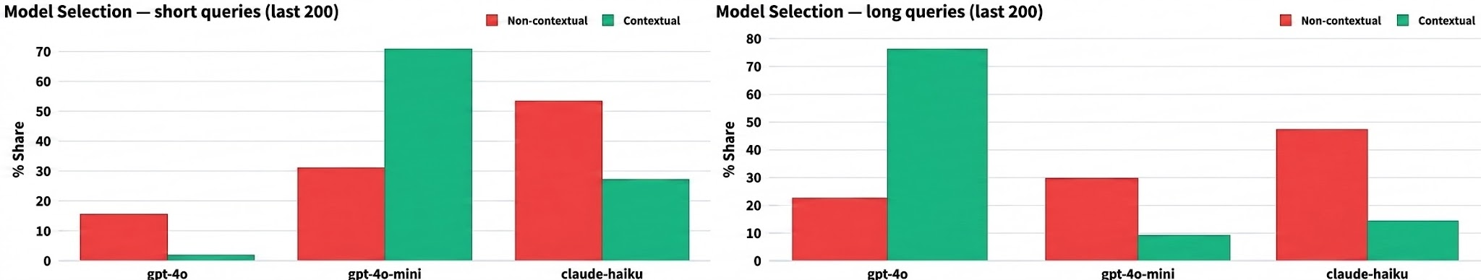
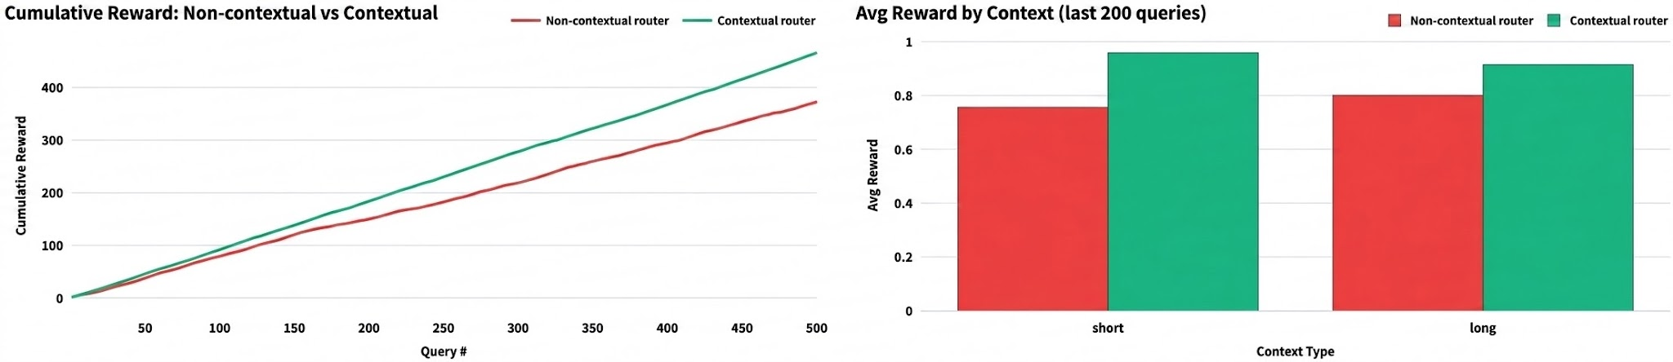
Future Work

Slide 21
Thank You
code
download_for_offline
GitHub Repository
github.com/shrinidhi-mahishi/model_routing
PyPI Package
pip install bayesian-router

Slide 22
Questions?

